Slide 1

TIMECRAFT
iHUB DivyaSampark
@IIT Roorkee
Presented By:
Anu S M
Building an Innovation Tribe…

Slide 2
Team Details
Name: Anu S M Branch: Bachelor of Engineering in Computer Science(Cybersecurity) College: M S Ramaiah Institute of Technology, Bengaluru Sem: 05

Slide 3
Name of Project
TimeCraft- Making Text Conversations Smarter with Intelligent Reminders

Slide 4
Introduction
Problem: The sheer volume of information exchanged on WhatsApp, Messages, and Email poses a unique challenge- Information overload. As users engage in diverse conversations, from personal discussions to professional collaborations, the critical details embedded in messages, such as event dates, locations, and times, can easily get lost amidst the digital noise. .

Slide 5
Introduction
Solution: Introducing “TimeCraft(Smart and Intelligent Reminders)," a system that extracts dates, times, and locations from WhatsApp messages and automatically sets reminders 24 hours prior. Target Audience: Busy professionals, students, and anyone juggling active WhatsApp, Messages and Email communication.

Slide 6
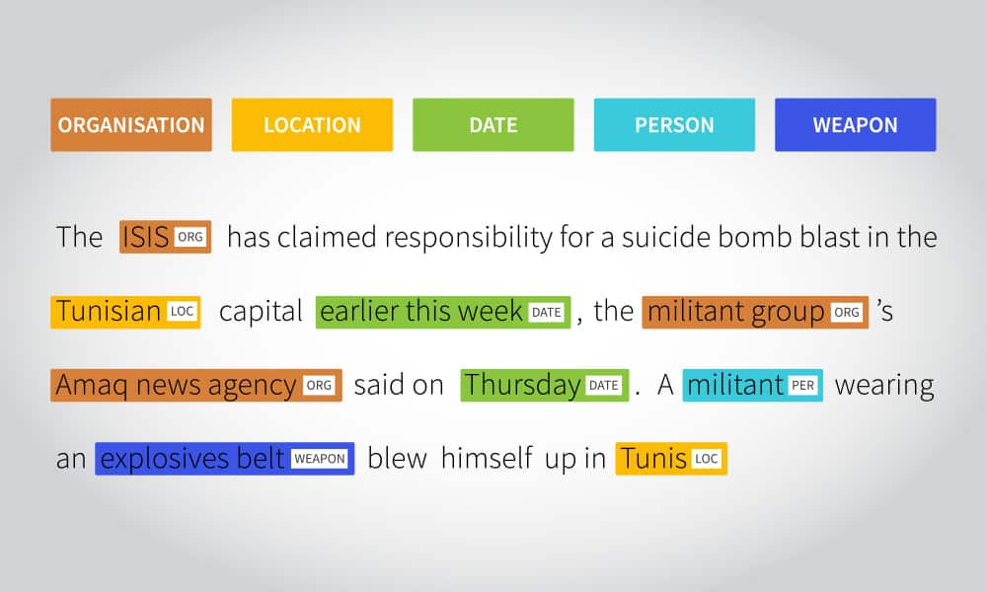
Project Idea/Details
TimeCraft
Leverage NLP technology to automatically extract dates, times, and locations from text messages and set personalized reminders 24 hours beforehand.

Slide 7
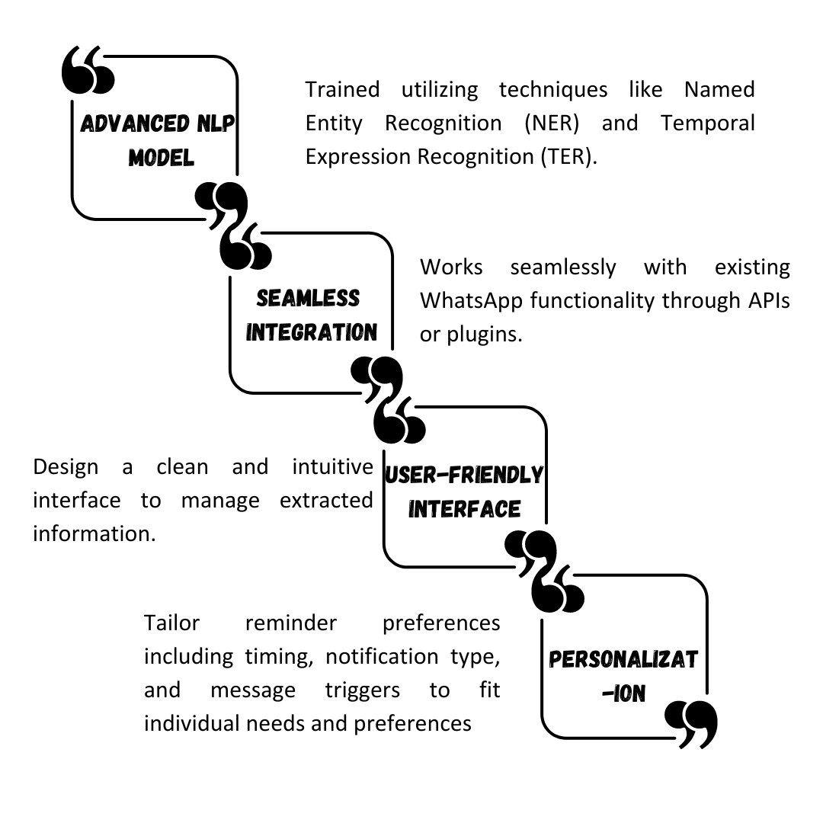
Project Idea/Details
Technology

Slide 8
Project Idea/Details
Key Features
Automatic Deadline Extraction
24-Hour Reminder Alerts
Location-Based Reminders
Group Collaboration
Data Insights

Slide 9

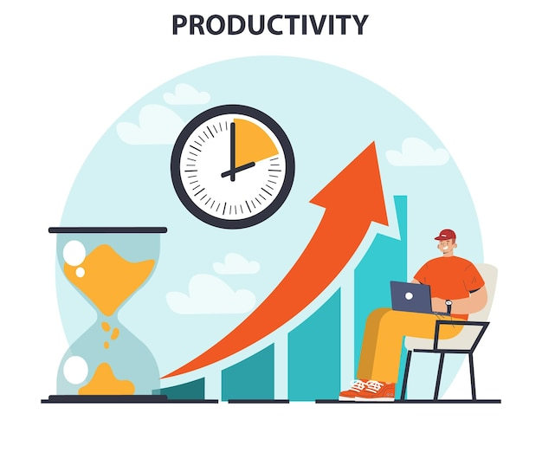
Significance/Need of Project
Smart Cities Initiative
Contributes to the realization of intelligent and connected urban spaces. a progressive step towards shaping the cities of the future.
Recognizes the productivity bottleneck and aims to streamline the process by automating the extraction of essential details.

Slide 10


Significance/Need of Project
Reduced Stress and Anxiety
Avoid the constant worry of missed deadlines and forgotten commitments, leading to a calmer and more focused mind.
Enhanced Communication and Collaboration
Foster better coordination and accountability within WhatsApp groups, streamlining workflows and projects.

Slide 11

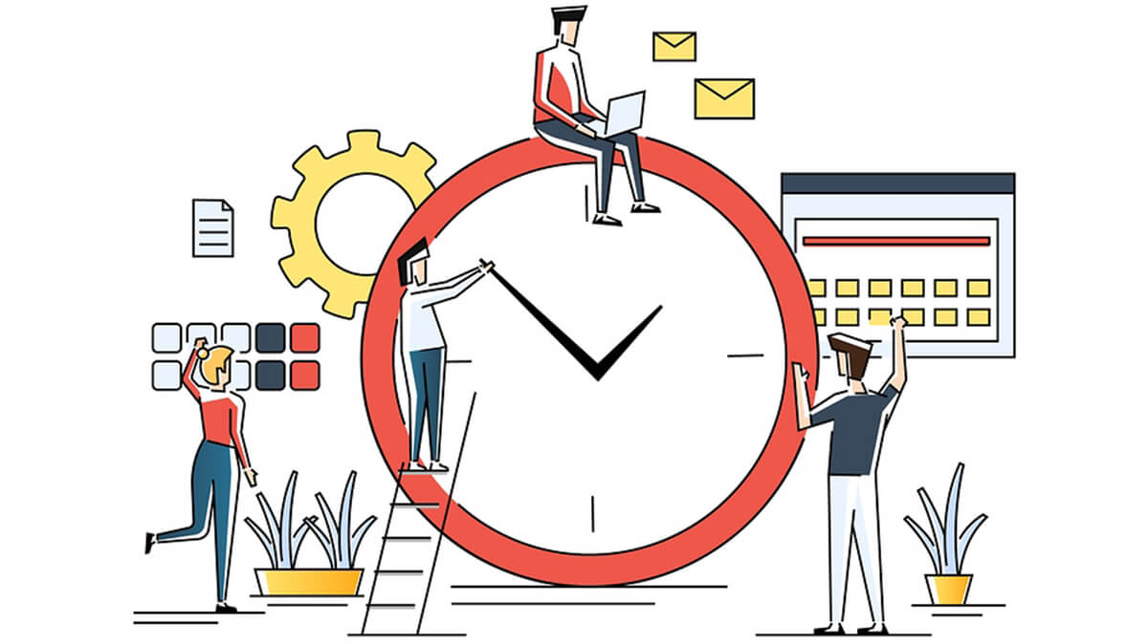
Significance/Need of Project
Data-Driven Personalization
Tailor reminder settings and insights to individual needs and preferences, maximizing the system's effectiveness.
Time Management
Urban dwellers, often face the constant challenge of optimizing their time to meet deadlines, attend events, and maintain a work-life balance.

Slide 12
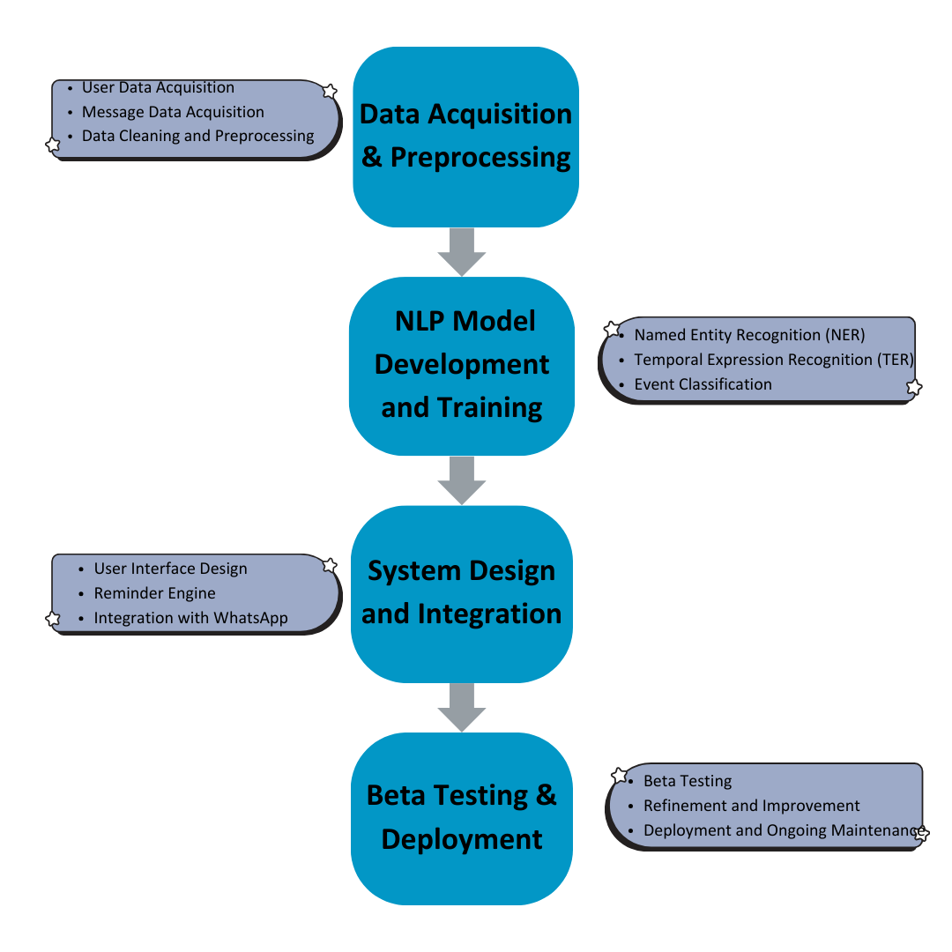
Methadology

Slide 13
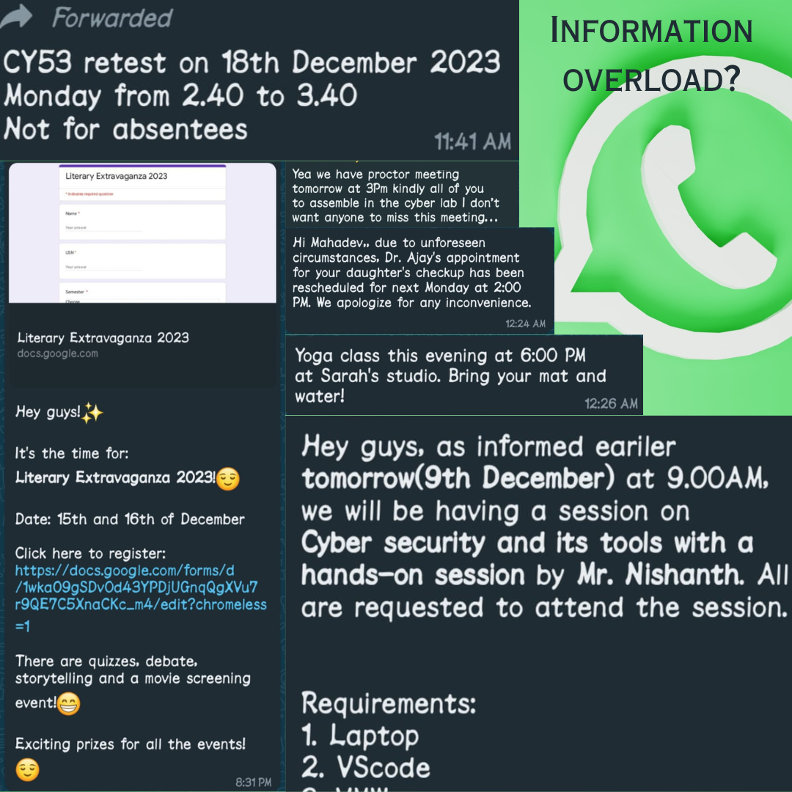
Outcomes/Deliverables

Slide 14
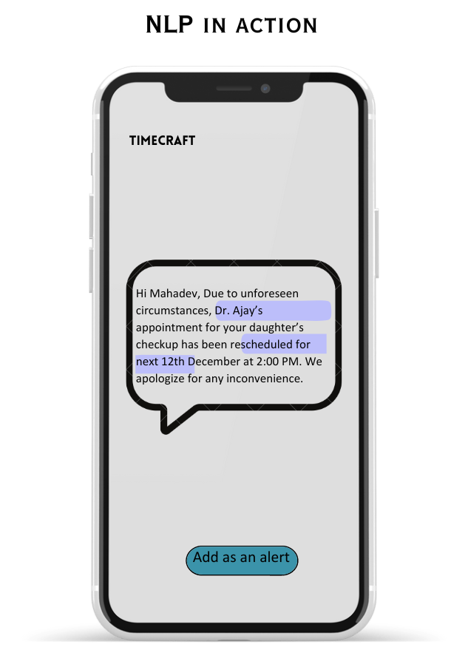
Outcomes/Deliverables
System Demonstration
1. Named Entity Recognition (NER):
Use a pre-trained NER model like spaCy to identify key entities
PERSON: "Mahadev", "Dr. Ajay"
DATE: "December 12th"
TIME: "2:00 PM“
2. Rule-based Parsing:
Identify "appointment" based on keywords like "rescheduled", "checkup", "appointment".
Link the identified appointment to "Dr. Ajay" based on the proximity of their names.

Slide 15
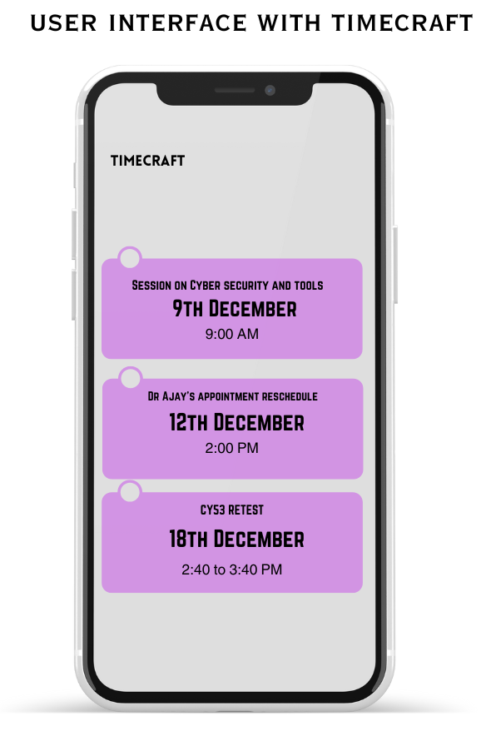
Outcomes/Deliverables
Storing the Extracted Temporal Information to remind the user early.
Prioritizes conflicting events based on user preference.

Slide 16
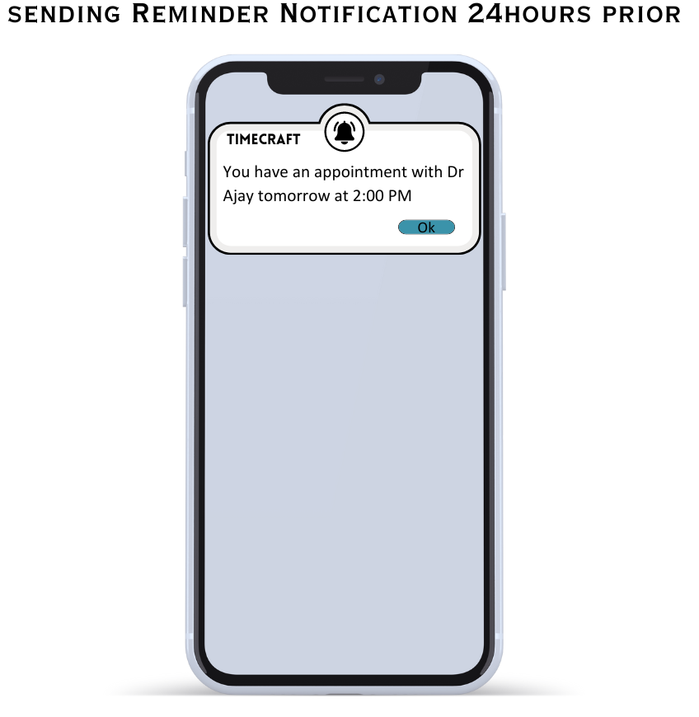
Outcomes/Deliverables
Sending an alert or notification to remind the user about the type of event 24 hours prior.

Slide 17
Expected Time Duration/ Action Plan
Initiation (1 weeks)
Requirements Analysis (2 weeks)
Tech Stack Selection (1 weeks)
System Design (3 weeks)
NLP Model Development (4 weeks)
Key Milestones
Project Kick-off
Requirements Document
Technology Stack Selection
System Architecture Design
NLP Model Development Complete

Slide 18
Expected Time Duration/ Action Plan
WhatsApp Integration (2 weeks)
Database Implementation (3 weeks)
Reminder Scheduling System (3 weeks)
User Personalization (4 weeks)
Conflict Resolution Algorithm (2 weeks)
Key Milestones
WhatsApp Integration
Database Implementation
Scheduling Algorithm
User Personalization
Conflict Resolution

Slide 19
References
Spacy: Industrial-strength Natural Language Processing" by spaCy Project (2023)
Extraction of temporal information from social media messages using the BERT model.
"Named Entity Recognition for Time and Location: A Survey" by J. Li et al. (2017)
Google Scholar

Slide 20


Thank
You

